Slide 1
Visualizing Attack Graphs, Reachability, and Trust Relationships with NAVIGATOR*
Matthew Chu, Kyle Ingols, Richard Lippmann,
Seth Webster, Stephen Boyer
MIT Lincoln Laboratory
14 September 2010
*This work is sponsored by the United States Air Force under Air Force Contract FA8721-05-C-0002. Opinions, interpretations, conclusions and recommendations are those of the authors and are not necessarily endorsed by the United States Government
Notes:
Introduce paper and authors

Slide 2
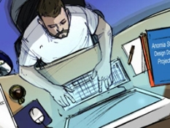


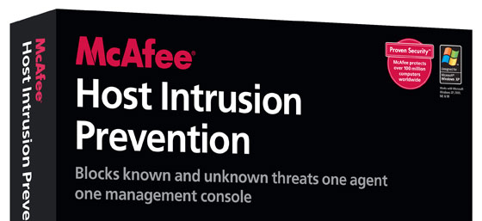




A Defender’s Primary Advantage is Detailed Network Knowledge – This Needs to Be Used Effectively!
Specify Asset Values
and Adversary
Infer Network Topology
From Infrastructure Rules
Discover
Vulnerabilities
Define Vulnerability
Requirements/Effects
Notes:
The primary advantage a network defender has over an attacker is detailed knowledge of a network. For example, a system administrator knows which assets are most important and the adversary type that is of most concern. Routers and firewalls, including personal or host-based firewalls, define the network topology and reachability between hosts. Vulnerability scanners can be used to discover known vulnerabilities on the network, and online databases can be used to understand the requirements to exploit these vulnerabilities and the privileges or effects exploits provide. Unfortunately, currently, this information is largely independent and not integrated to provide an overall model of network security.

Slide 3
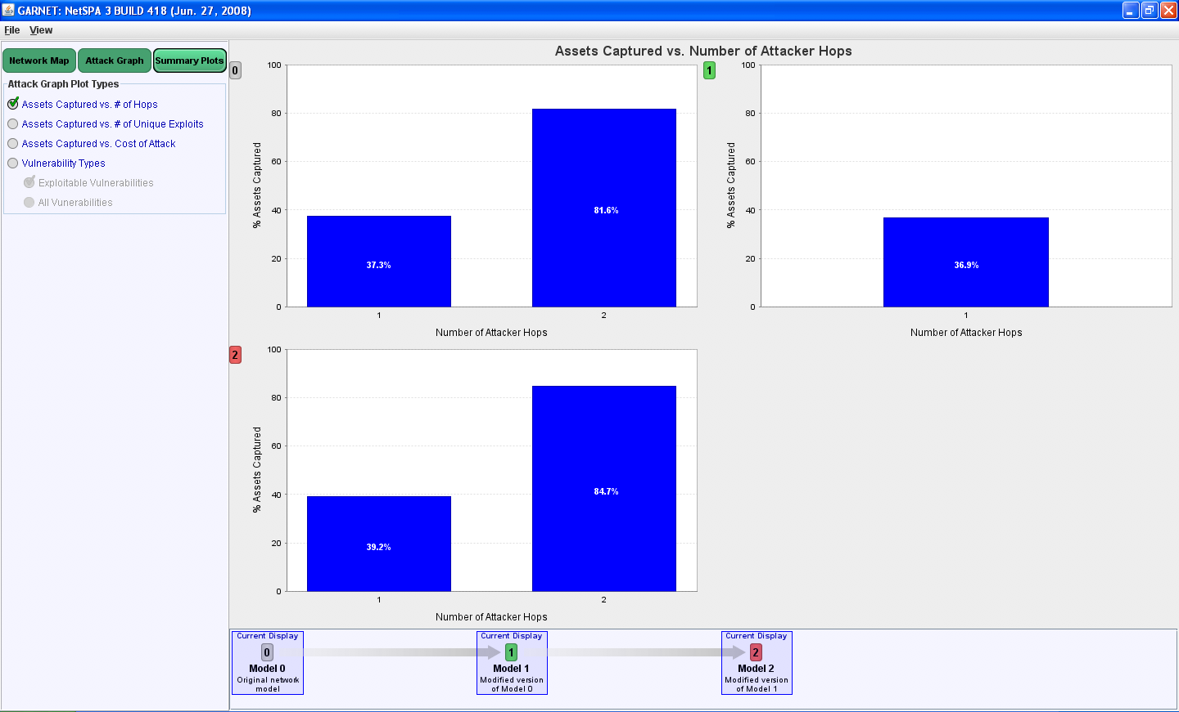
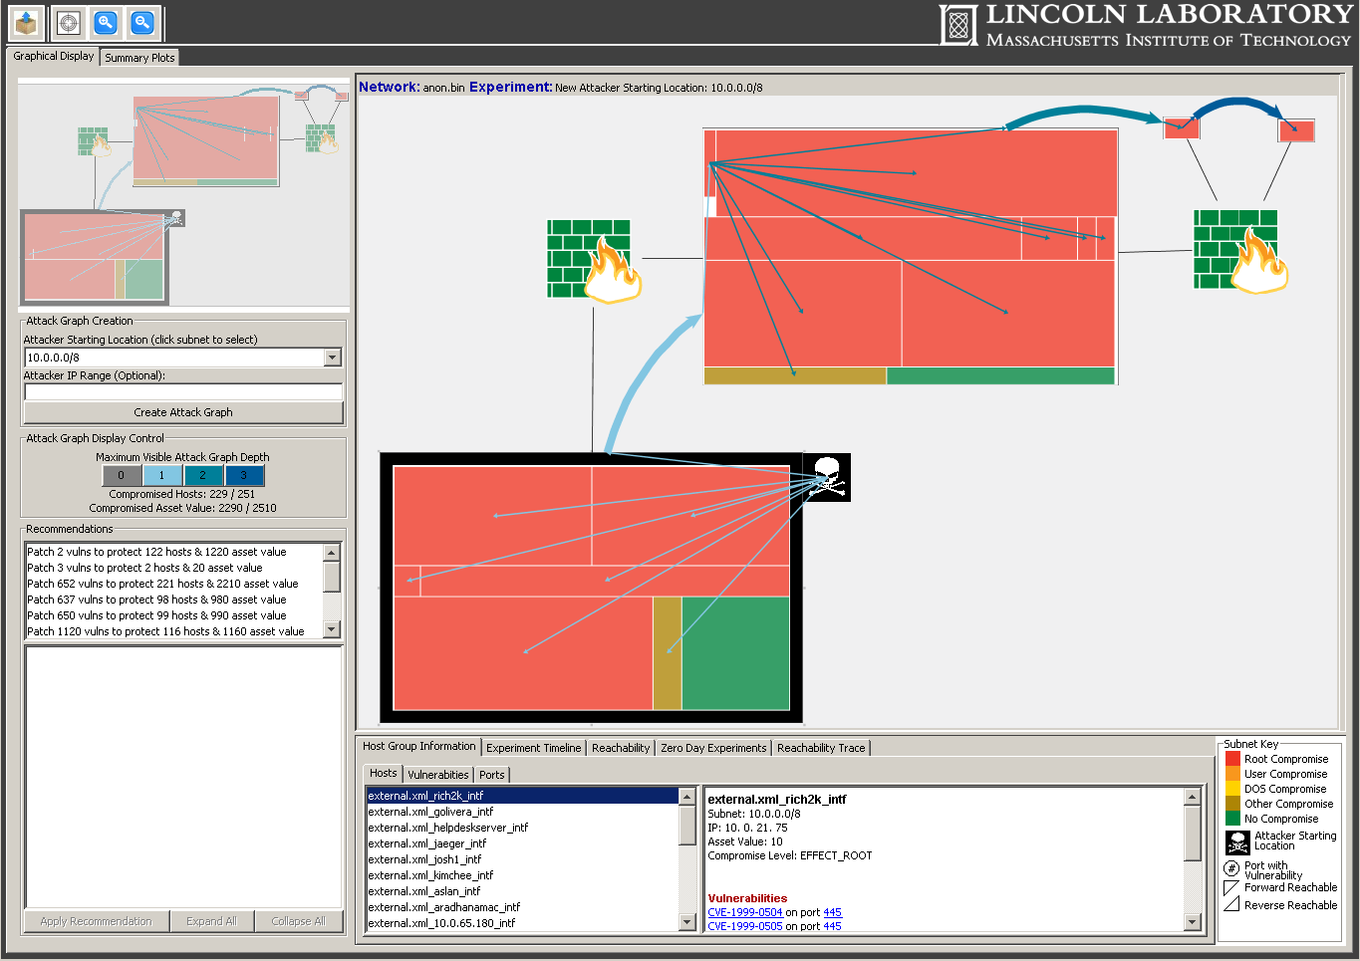
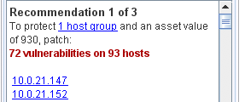
A Tool Named NetSPA Integrates This Data and Supports “What If” Experiments
Infer Network Topology
Adversary
What If ?
Defenses
Construct Network Model
Host Asset Values
Compute Host-to-Host Reachability
Metrics
Attack Graph
NVD
Recommendations
Notes:
A tool named NetSPA (Network Security Planning Architecture) was created to bring this information together and analyze network security using attack graphs. It inputs the data sources described on the previous slide, infers the network topology, builds a network model, and calculates host-to-host reachability for this network using firewall and router filtering rules. NetSPA then creates an attack graph and generates recommendations to improve security and also security metrics from the attack graph. It also supports “What-If” experiments where a user can change host asset values, defenses such as firewall filtering rules and patches, and the adversary model including starting location and abilities to exploit known vulnerabilities and create zero-day attacks for currently unknown vulnerabilities. GARNET was a software tool created to provide easy access to these capabilities of NetSPA.

Slide 4
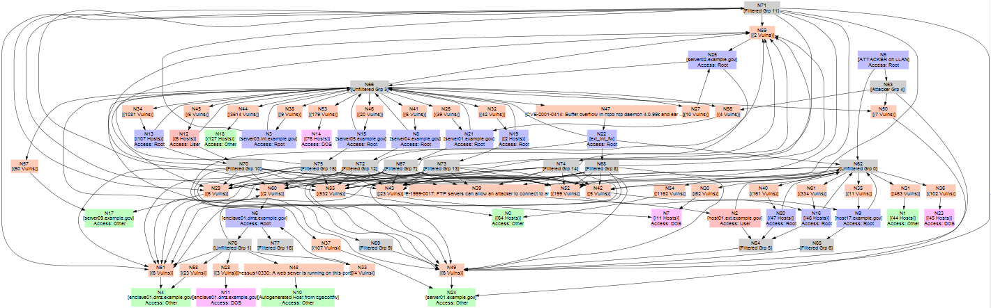
Attack Graphs Can Be Difficult to Understand
Notes:
Attack graphs, when displayed as node-link graphs, become confusing tangles of edges, even when grouping and hierarchical displays are used.
The attack graph, therefore, is a very useful intermediate computational product, but is not useful to a human

Slide 5
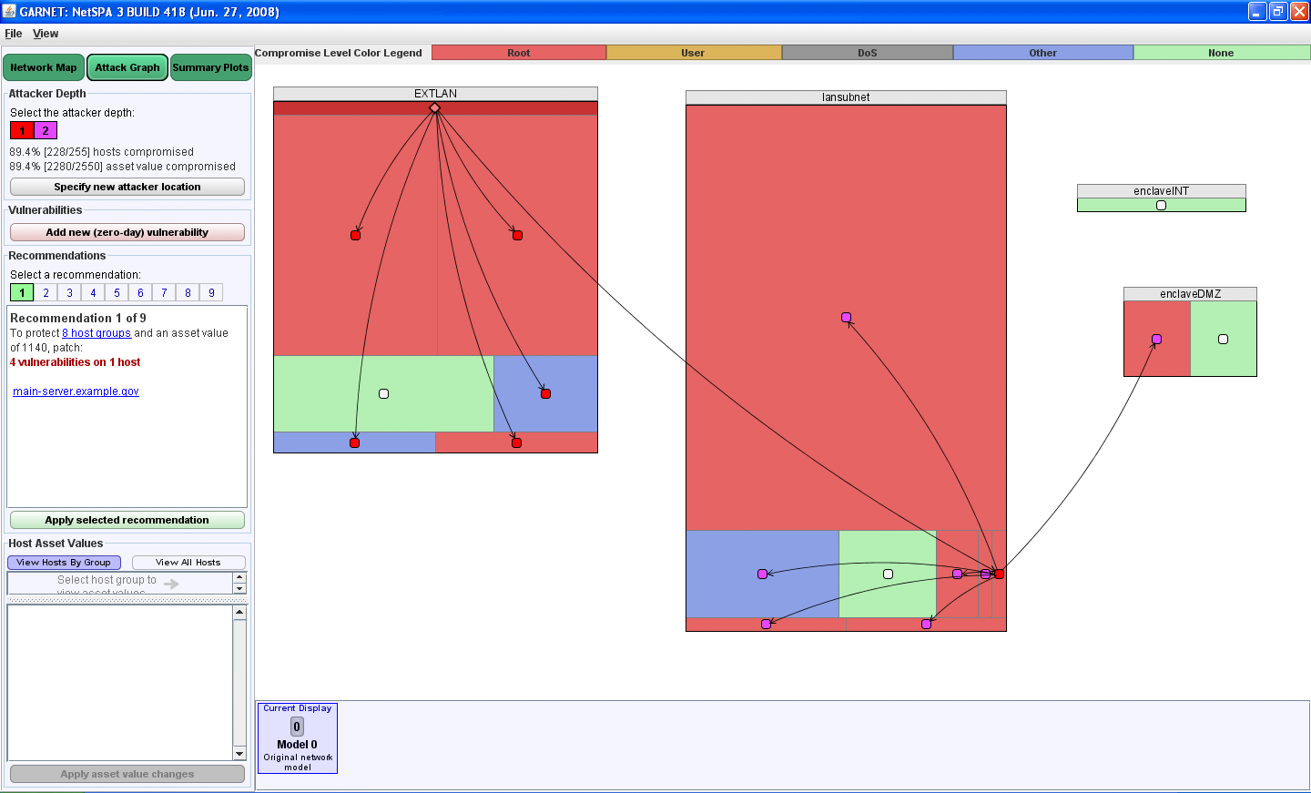
Previous NetSPA GUI: GARNET
Many of its key features have been kept intact
Ability to perform “What-If” experiments
Network level metrics
Major shortcomings have been addressed
Notes:
We previously developed a NetSPA GUI called GARNET, which was a step forward in the area of attack graph visualization. Many of its key features have been kept intact, but we have found shortcomings that needed to be addressed. Also, some recent upgrades to the NetSPA engine opened up additional information that could be displayed by NAVIGATOR.

Slide 6
NAVIGATOR
Notes:
-explain the gui: what the colors mean, what the shapes/icons mean, what the arrows mean

Slide 7
Outline
Introduction
New Features
Client side vulnerabilities and trust relationships
Network infrastructure
Host level zooming
Enhancements
Conclusion
Notes:
Go over outline of talk

Slide 8
Client-side Attacks and Trust Relationships
Client-side attacks are an increasingly common attack vector that rely on vulnerable client software connecting to a malicious server
Attackers also exploit trust relationships, where certain machines are given high level privileges on other machines without passwords or other verification
Differentiating between server-side, client-side, and trust relationship attacks is important because their respective countermeasures vary greatly
Notes:
Explain what client-side attacks and trust relationships are
Explain why differentiating between them is important

Slide 9
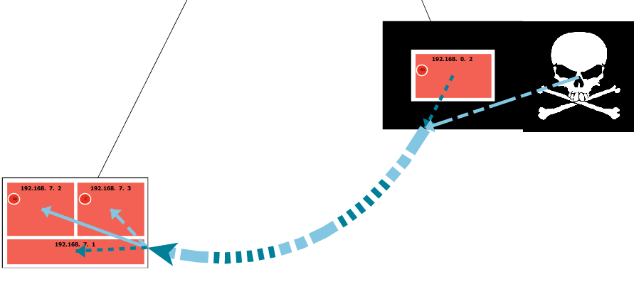
Differentiating Between Attack Types
Hybrid line = Server and Client Side
Single edge between subnets to reduce clutter and emphasize the important attack steps
Solid line = Server Side Attack
Show multiple attack types
Dashed line = Client Side Attack
Show multiple attack depths
Dotted line = Trust Relationship Attack
Notes:
-describe different line types and colors
-describe new single edge between subnets

Slide 10
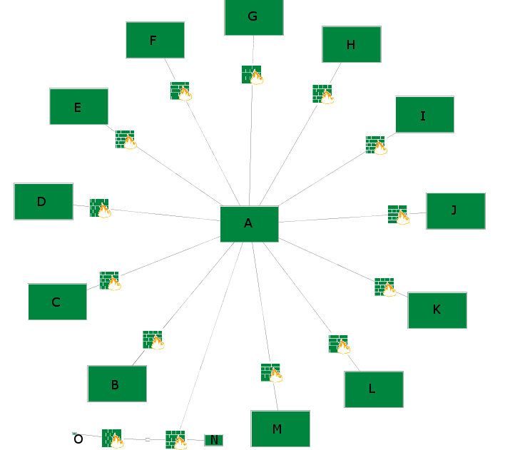
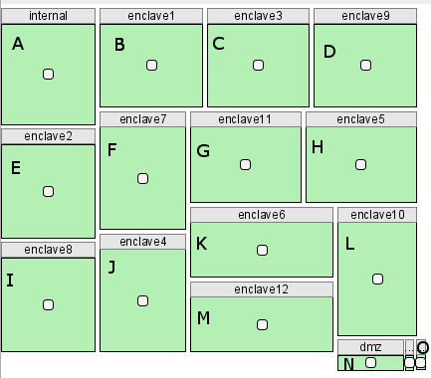
Show Infrastructure
GARNET’s view
NAVIGATOR’s view
Notes:
-why it’s important to show infrastructure
-use of icons to show compromise to device itself

Slide 11
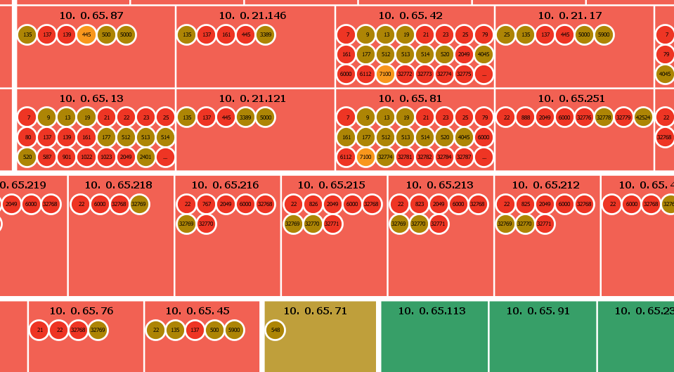
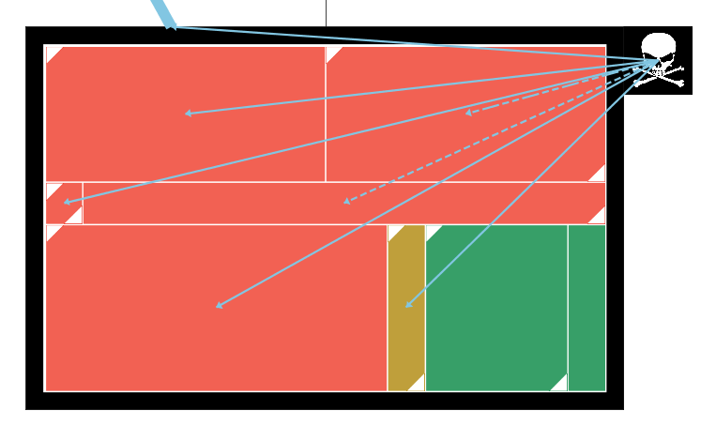
Allow Zooming to the Host Level
Notes:
-describe host group level and how eventually making the host groups bigger is no longer useful
-talk about showing of individual hosts, what circles mean
-what circles mean, what … means

Slide 12
Outline
Introduction
New Features
Enhancements
Host Group Visualization
Reachability
Speed
Conclusion
Notes:
Go over outline of talk

Slide 13
Host Group Visualization
GARNET’s method: the strip treemap algorithm
Did not take into account asset values
Gives no guarantees about aspect ratios
Criteria for choosing NAVIGATOR’s approach
Handle multiple asset values
Only a small amount of wasted space
Rectangular shapes
Maintain order
Notes:
Talk about what asset value is and why it’s important to show
What aspect ratio is and why it’s important to have guarantees (easier interaction, etc.)
Go through each of the criteria in detail

Slide 14
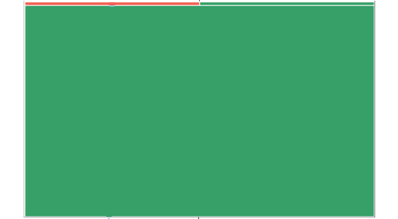
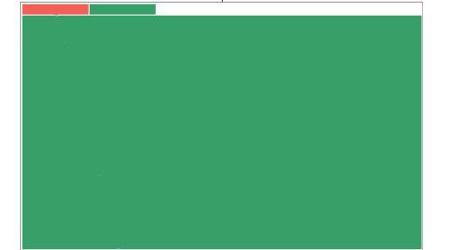
Solution: Modified Strip Treemap Algorithm
Guarantees minimum dimension for all rectangles by altering their dimensions when placed
Cost of this modification is some wasted space
Notes:
Some detail about the strip treemap algorithm and how we’ve changed it
How this meets all of the criteria described on the previous slide

Slide 15
Improved Visualization of Reachability
Triangle in Upper Left = Forward Reachability
Triangle in Bottom Right = Reverse Reachability
Uses symbols instead of arrows to reduce clutter
Shows reachability and attack graph edges at the same time to identify latent threats
Notes:
-use of symbols/ differentiate between forward and reverse reachability

Slide 16
Improved System Speed
NetSPA is capable of analyzing the large, complex networks often found in the government or large corporations
Because of preloading, GARNET was slow on some of the more data intensive operations
NAVIGATOR loads information on demand
Engine is often fast enough that user cannot distinguish between preloading and on demand loading
For other situations, information is shown as it is calculated
On a network of 20,000 hosts spread over 100 subnets, NAVIGATOR loaded in 1 second but GARNET took over 90 seconds
New backend graph format specifically designed for visualization allows faster analysis
Notes:
Talk about backend changes to the system that resulted in better speed and usability

Slide 17
Outline
Introduction
New Features
Enhancements
Conclusion
Notes:
Go over outline of talk

Slide 18
Conclusion
NAVIGATOR visualizes attack graphs and network reachability
First attack graph visualization tool to display effect of client-side, trust-based, and credential-based attacks
Greatly improves NetSPA’s previous GUI, GARNET
Displays infrastructure devices
Displays host-level data
Improved visualization of host groups and reachability
Improved overall system speed
Notes:
Conclude by going over the main points
Attack graph visualization firsts
Improvements over GARNET

